Slide 1
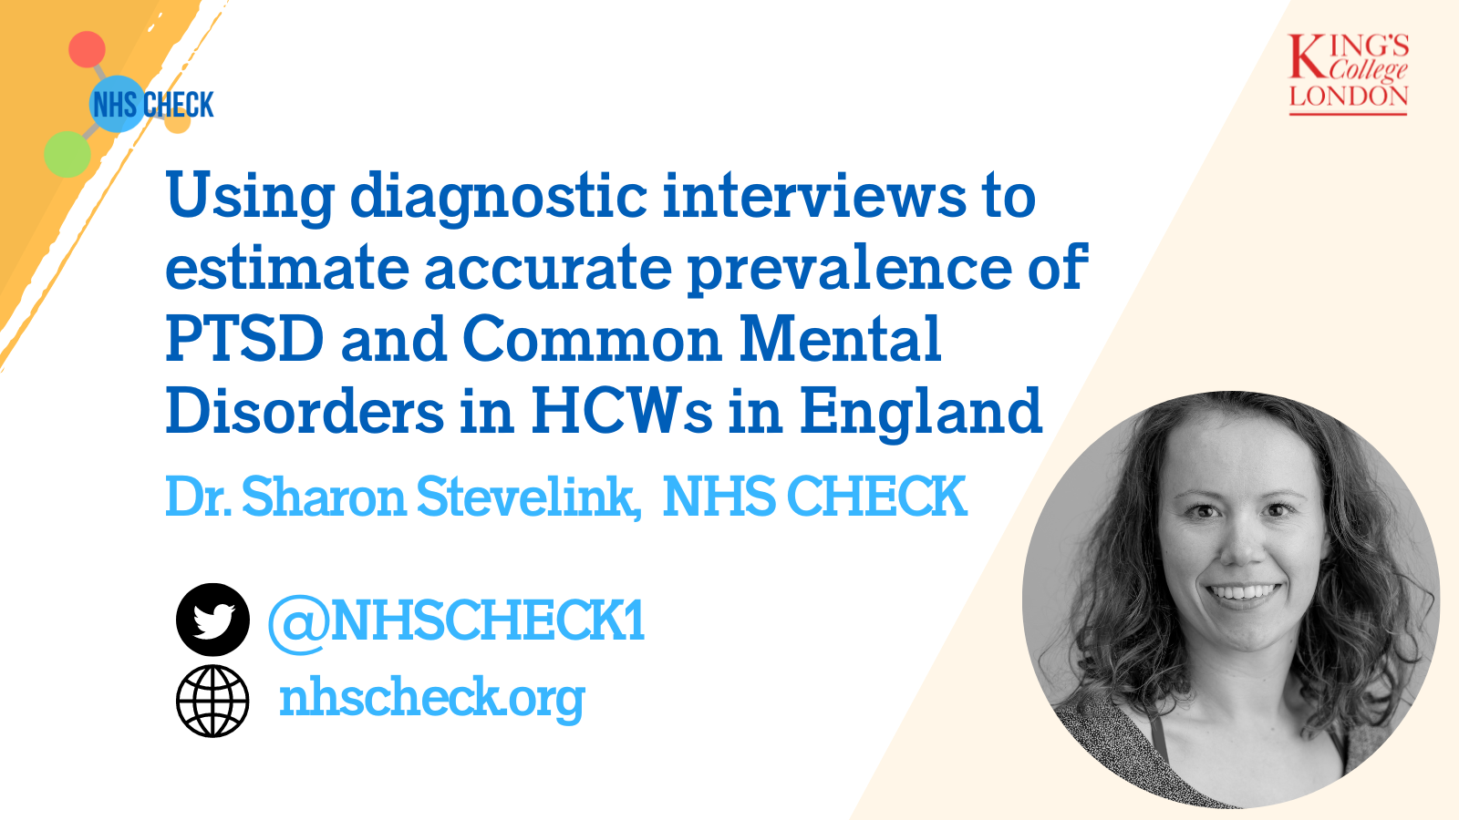

Slide 2

Adverse mental health prevalences vary widely across studies
9-90%
5-65%
7-37%
ANXIETY
DEPRESSION
PTSD
Mostly cross-sectional, online, frontline staff
Notes:
Numerous studies have examined the impact of the COVID-19 pandemic on the mental health and wellbeing of healthcare workers (HCWs). We conducted a scoping review that resulted in the inclusion of numerous studies with a wide global reach and including a range of HCW populations, however often focusing on frontline staff only, and in particular nursers and doctors.
Most studies provided estimates of several mental disorders; most commonly anxiety and depression and less frequently PTSD. Prevalence estimates of all three disorders varied widely (9-90%, 5- 65%, and 7-37% respectively). The individual studies described in the reviews were typically cross-sectional and employed a range of screening tools to assess PTSD, depression and anxiety, and were commonly administered through self report online surveys.

Slide 3
Screening measures tend to overestimate prevalence estimates
Notes:
Our scoping review showed that existing studies of the prevalence of mental disorder in HCWs (over the course of the COVID-19 pandemic, but also outside that time window) have usually relied on screening tools to assess prevalence which has generated a wide range of estimates. Generally, a screening tool is a brief measure that identifies so-called caseness, on the basis of mental health symptoms, characteristics, or traits. Typically, a cutoff score is used as an indicator of probable mental disorder or clinically significant symptoms. This method allows for relatively rapid and low-cost data collection with large samples. They can just be send out via email/paper with less of need for trained staff and are quick to do. Hence the reliance on these measures. However, its also known that cut off scores on screening tools favour sensitivity over specificity meaning that they are more likely to incorrectly identify HCWs as meeting criteria for mental disorders (so false positives).
The diagnostic interviews used in this study provide a more accurate estimate of prevalenceof mental disorders in healthcare workres

Slide 4
A two-phase epidemiological design for a more accurate estimate of CMD and PTSD in healthcare workers
Screening tool
General Health Questionnaire
Diagnostic interview
Clinical Interview Schedule-Revised (CIS-R)
PTSD Checklist
Clinician Administered PTSD Scale (CAPS)
Notes:
Our study used a two-phase epidemiological design as a sensible approach to generate more accurate estimates of the prevalence of common mental disorders and PTSD in representative population of HCWs. We administered both screening tools for these mental disorders (the 12-item General Health Questionnaire (GHQ-12) and the 6 item Post-Traumatic Stress Disorder checklist (PCL-6) and diagnostic interviews (the Clinical Interview Schedule-Revised (CIS-R) and the Clinician Administered PTSD Scale (CAPS-5) for the DSM-5) to HCWs in England.

Slide 5
251 healthcare workers assessed for CMD and 96 for PTSD using diagnostic interviews
Half of the sample was selected based on meeting
the GHQ or PCL-6 caseness criteria at baseline
Use of weighing and the diagnostic interview estimates to ensure generalizability to healthcare workers in England
Notes:
As part of the diagnostic interviews we interviewed 251 healthcare workers and assessed them for common mental disorders using the CIS-R, as well as an additional 93 healthcare workers and assessed them for PTSD using the CAPS. These HCWs were selected based on their answers to the NHS CHECK baseline screening tools for CMD And PTSD. We ensure that half of the sample met caseness on the screening tools and the other half did not.
We then used weighing and the results from the diagnostic interviews to calculate the more accurate prevalence for the population at risk, in this case healthcare workers in England. This also ensured our diagnostic interview study results are generalisable to HCWs across England.
NHS CHECK baseline assessment data from the 6-item PCL (8) was used to identify participants with or without probable PTSD using a score of ≥14 to indicate caseness and the 12-item GHQ (9) was used to identify those with or without probable CMDs using a score of ≥4 to indicate caseness.
The demographic composition of the two diagnostic interview samples were relatively similar to the screening sample, being
predominantly White, female, clinical staff, and with larger proportions of younger participants than older. However, people from a white ethnic background were overrepresented in the interview samples compared to the composition of all NHS staff across the 18 participating Trusts.

Slide 6
Population prevalences about 2-3 times lower in diagnostic interviews vs. screening tools
 | Screening tool (GHQ-12/PCL-6) % (95% CI) | Diagnostic interview (CIS-R/CAPS) % (95% CI)
Common mental disorders | 52.8 (51.7-53.8) | 21.5 (16.9-26.8)
Generalised Anxiety Disorder | NA | 14.3 (10.4-19.2)
Depression | NA | 13.7 (10.1-18.3)
PTSD | 25.4 (24.3-26.5) | 7.9 (4.0-15.1)
Notes:
The prevalence estimates of screening and diagnostic measures are summarised in this table. The prevalence of GHQ caseness in the screening sample was 52·8% (95% CI 51.7 to 53.8). Using the CIS-R questionnaire as a gold standard, the population validated prevalence of generalised anxiety disorder is estimated to be 14.3% (95% CI 10.4 to 19.2) and of depression is estimated to be 13.7% (95% CI 10.1 to 18.3). The combined population validated prevalence of generalised anxiety disorder and depression derived from the CIS-R questionnaire was 21.5% (95% CI 16.9 to 26.8). The prevalence of PTSD (using PCL-6 outcome measure) in our screening sample was 25·4% (95% CI 24.3 to 26.5), whereas the population validated prevalence using the CAPS questionnaire as a gold standard was
estimated to be 7.9% (95% CI 4.0 to 15.1).

Slide 7
One in five of HCWs are likely to meet criteria for a diagnosable mental disorder
Overestimation of mental disorder prevalence
estimates when using screening measures
Further calibration needed when using screening tools
Implications for workplace functioning, treatment and service planning
Notes:
Our results suggests that the screening tools with commonly used cut-off scores, utilised by many studies, substantially overestimate the prevalence of mental disorders. However, our data show that around 1-in-5 of HCWs are likely to meet criteria for a diagnosable mental disorder. Whilst evidence suggests that HCWs operating in challenging environments will often work through potentially traumatic events without the need for clinical intervention, given the known link between diagnosable mental disorders and poor workplace functioning we suggest it may be helpful to provide treatment promptly for HCWs with diagnosable mental disorders. This approach is likely to both benefit HCWs themselves as well as ensure quality of care for patients by maintaining a well-functioning workforce. More broadly, researchers seeking to assess psychiatric symptoms using self-report screening tools should carefully consider what cut-off scores to use on screening tools, and ideally carry out further validation work to correctly calibrate measures to be appropriately sensitive. Studies of mental disorder in HCWs using screening tools are likely to have overlabelled distress as diagnosable disorder. Over-estimating the rates of mental disorders is unhelpful, with the risk of over treatment and inappropriate medicalisations and professionalisation of distress.

Slide 8
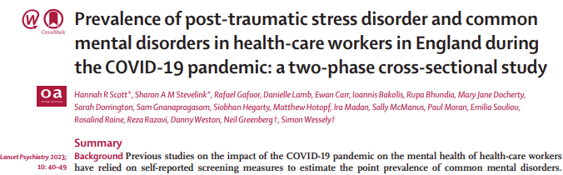
Thank you
Email: Sharon.Stevelink@kcl.ac.uk; nhscheck@kcl.ac.uk
Website: www.nhscheck.org
Twitter: @NHSCHECK1

Slide 9
Conflict of interests
MH, RR, and SW are senior NIHR Investigators.
SW has received speaker fees from Swiss Re for two webinars on the epidemiological impact of COVID 19 pandemic on mental health. SW is a board member of NHS England.
RR reports grants from DHSC/UKRI/ESRC COVID-19 Rapid Response Call, grants from Rosetrees Trust, grants from King's Together rapid response call, grants from UCL (Wellcome Trust) rapid response call, during the conduct of the study; & grants from NIHR outside the submitted work.
MH reports grants from DHSC/UKRI/ESRC COVID-19 Rapid Response Call, grants from Rosetrees Trust, grants from King's Together rapid response call, grants from UCL Partners rapid response call, during the conduct of the study; grants from Innovative Medicines Initiative and EFPIA, RADAR-CNS consortium , grants from MRC, grants from NIHR, outside the submitted work.
SS reports grants from UKRI/ESRC/DHSC, grants from UCL, grants from UKRI/MRC/DHSC, grants from Rosetrees Trust, grants from King's Together Fund, and an NIHR Advanced Fellowship [ref: NIHR 300592] during the conduct of the study.
NG reports a potential COI with NHSEI, during the conduct of the study; and I am the managing director of March on Stress Ltd which has provided training for a number of NHS organisations.
The views expressed are those of the authors and not necessarily those of the NHS, the NIHR, or the Department of Health and Social Care.
Other authors report no competing interests.

Slide 10
Funding
Funding for NHS CHECK was received from the following sources: Medical Research Council (MR/V034405/1); UCL/Wellcome (ISSF3/ H17RCO/C3); Rosetrees Trust (M952 and PGL22/100103); Economic and Social Research Council (ES/V009931/1); NHS England and NHS Improvement; Manolo Blahnik International; Koa Health; Colt Foundation; as well as seed funding from National Institute for Health Research Maudsley Biomedical Research Centre, King's College London, National Institute for Health and Care Research Health Protection Research Unit in Emergency Preparedness and Response at King's College London.

Slide 11
Acknowledgement
We wish to acknowledge the National Institute of Health and Care Research (NIHR) Applied Research Collaboration (ARC) National NHS and Social Care Workforce Group, with the following ARCs: East Midlands, East of England, South West Peninsula, South London, West, North West Coast, Yorkshire and Humber, and North East and North Cumbria. They enabled the set-up of the national network of participating hospital sites and aided the research team to recruit effectively during the COVID-19 pandemic.
The NHS CHECK consortium includes the following site leads: Siobhan Coleman, Sean Cross, Amy Dewar, Chris Dickens, Frances Farnworth, Adam Gordon, Charles Goss, Jessica Harvey, Nusrat Husain, Peter Jones, Damien Longson, Paul Moran, Jesus Perez, Mark Pietroni, Ian Smith, Tayyeb Tahir, Peter Trigwell, Jeremy Turner, Julian Walker, Scott Weich, Ashley Wilkie.
The NHS CHECK consortium includes the following co-investigators and collaborators: Peter Aitken, Ewan Carr, Anthony David, Mary Jane Doherty, Sarah Dorrington, Rosie Duncan, Sam Gnanapragasam, Cerisse Gunasinghe, Stephani Hatch, Danielle Lamb, Daniel Leightley, Ira Madan, Richard Morriss, Isabel McMullen, Dominic Murphy, Martin Parsons, Catherine Polling, Alexandra Pollitt, Anne-Marie Rafferty, Rebecca Rhead, Danai Serfioti, Chloe Simela, Charlotte Wilson Jones.

Slide 12

Only study we know off that used diagnostic interviews in UK
Use of administrative data to create weights (ethnicity, age, sex and clinical role)
Clinical and non-clinical staff
Comparable characteristics to NHS workforce
Convenience sample of 18 NHS Trusts, low response rate to diagnostic interviews (13%)
Framing effect – occupational studies
Notes:
A major strength of our study was that our sample was weighted using administrative data to improve the representativeness of survey respondents to the target population in terms of ethnicity, age, sex and
clinical role. Whereas the response rate to the NHS CHECK cohort was not optimal, at 15.3%, we believe, it is the highest reported response rate compared to similar studies that have a known, identifiable, and
inclusive target population. The characteristics of our NHS CHECK sample are broadly comparable to NHS workforce statistics on a national level (28). We also included both clinical and non-clinical staff in
recognition of the burden that all HCWs have faced during the pandemic.
Our study was limited by several factors. It is based on participants from 18 NHS hospital Trusts who had completed the screening tools (GHQ-12 and PCL-6) at baseline. Although the sampling procedures gave a
good chance of achieving a representative sample of HCWs within each participating site, we did not include a random sample of English hospitals. We also had a relatively low response rate to the diagnostic
interview study (12.8%), and participants were self-selected responders to an already self-selected sample from our cohort study (7).
A further limitation that applies to all studies that focus on HCWs alone is the possibility of a contextual bias or framing effect that we have shown applies to studies that focus on any given workforce, such as
HCWs, teachers, police, military personnel and others (29). Such studies give higher mental disorder prevalences when compared to the results where occupation specific prevalences are extracted from
larger true population studies where occupation is collected as an incidental variable. More recent work on the impact of COVID-19, where population studies find lower prevalence estimates in HCWs, than do
surveys specifically of HCWs. Using diagnostic interviews may reduce this systematic bias by providing a more rigorous assessment of mental disorder less dependent on self-report but is unlikely to eliminate
this.

Slide 13

Estimated population prevalences were calculated for CMD and PTSD
Use of weighing and the diagnostic interview estimates to ensure generalizability to healthcare workers in England
Notes:
We estimated the prevalence of probable CMDs and PTSD using the screening tools (GHQ-12 and PCL-6). We then post-stratified based on GHQ binary outcomes, applied a post weight based on frequencies of the relative outcomes and finally
applied a finite population correction based on total population size (21,383) (15). These weighing adjustments were used to estimate the gold standard prevalence from the diagnostic measures for the
population at risk.
The prevalence of each outcome after diagnostic interviews (CIS-R for generalised anxiety disorder or depression and the CAPS-5 for PTSD) are presented as proportions with standard errors of the proportion
to assess uncertainty in the outcome measure. We also calculated a combined caseness measure (generalised anxiety disorder and/or depression) by combining the prevalence of both outcomes on the
CIS-R. To estimate the prevalence of each outcome in the population, we used the weighting strategy previously described. The screened point prevalence of each of the outcomes were tabulated after the
weighted continuous outcome scores were dichotomised by pre-determined cut-offs (>=4 for GHQ and >=14 for PCL-6) and ‘survey set’ using Stata statistical software. Survey setting allows for valid inference
to be made from the screening sample to the population risk taking into account Trust level clustering. This is done by using the individual level weights at the individual level and then post-stratifying using the
Trust sizes. Missing values were dropped in the estimation of the point prevalences and associated standard errors.
Through weighting and use of diagnostic interviews, accurate prevalence for the population at risk (English HCWs) was estimated.

