Slide 2
Moral Injury?
Profound distress following a ‘transgressive act’ that violates one’s moral or ethical code
Notes:
Not a mental illness Profound distress following a transgressive act that violates one’s moral/ethical code
Events: omission, commission, betrayal
Not limited to military – although most research is military focused

Slide 3
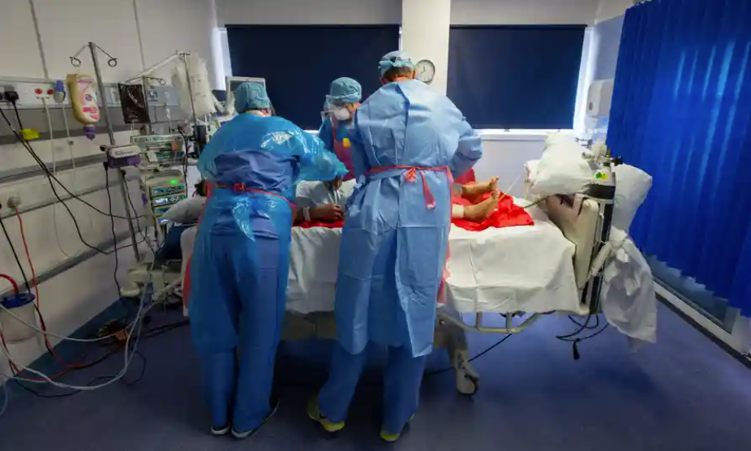
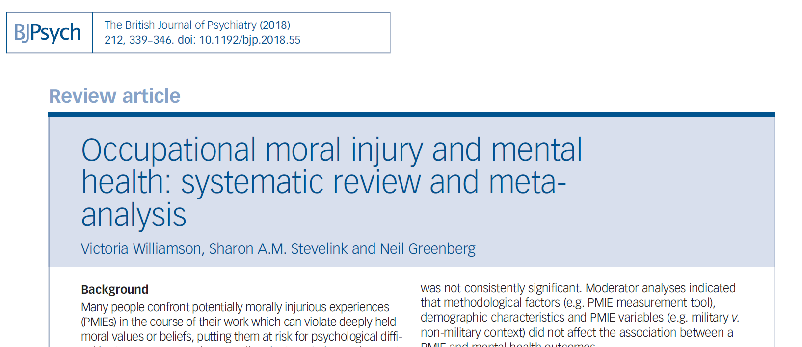
Potential Morally Injurious Events
Commission
I did things I should not have done
I am a monster
My team did things they should never have done
Omission
I froze and people died
I just let it happen
Betrayal [often, but not always, by a higher authority]
My supervisor had no interest in my safety
They lied to cover up their errors

Slide 4
Quantitative study n=12,965
Nearly a third of HCWs reported exposure to PMIEs
PMIE exposure associated with adverse mental health symptoms across clinical and non-clinical HCWs
Specific work factors were significantly associated with expressions of moral injury, including:
Redeployment
Lack of PPE (Personal Protective Equipment)
Experiencing a lack of support.
In all staff groups, those reporting more PMIE exposure reported worse mental health
(Lamb et al., 2021)

Slide 5
Potentially morally injurious events (PMIEs) and mental health outcomes in HCWs
% meeting caseness

Slide 6
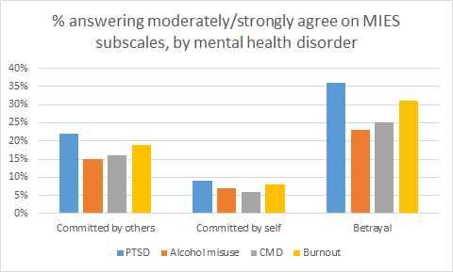
Types of potentially morally injurious events (PMIEs) in HCWs
% meeting caseness

Slide 7
Qualitative Study – Moral Injury
Primary Aim
Funded by Manolo Blahnik this study had the primary aim of better understanding the experience and impact of PMIEs in a sample of frontline HCWs during COVID in England
To explore how staff manage experiences of moral distress
To make recommendations to prevent/mitigate routine PMIE exposure among NHS staff
Secondary Aims

Slide 8
Methods

Slide 9
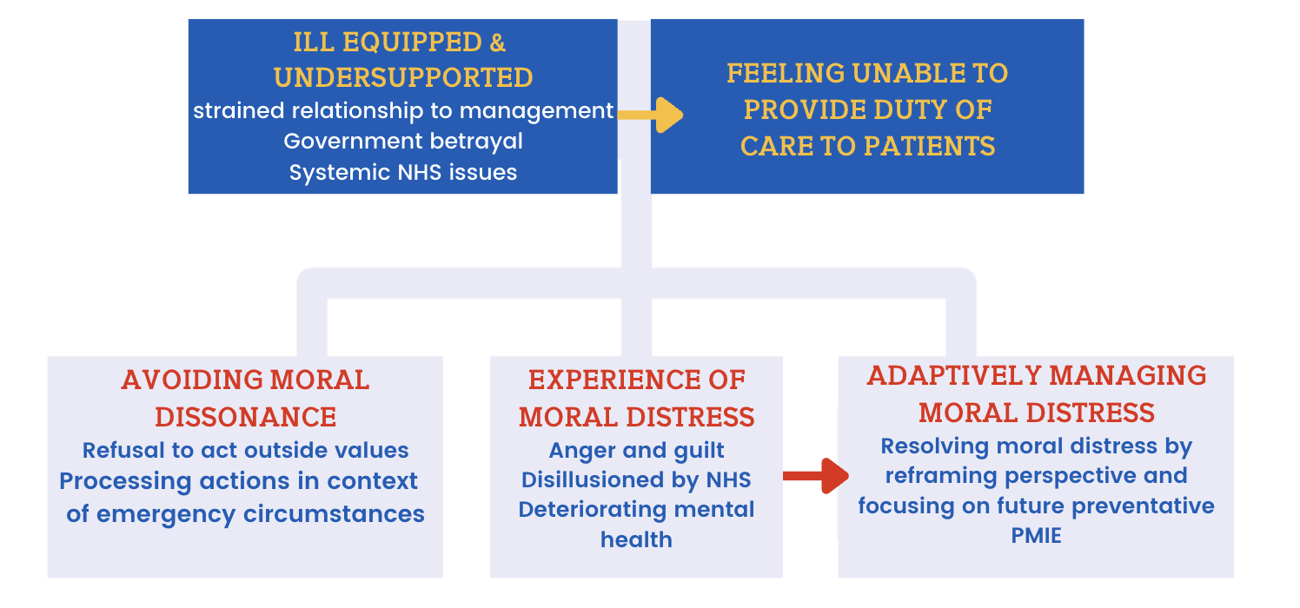
Findings

Slide 10
Impact of PMIE

Slide 11
Adaptive management of moral distress

Slide 12
Recommendations for change

Slide 13
Notes:
Creating the right culture involves making mental health a clear priority at a system level, meaning that wellbeing is recognised across stakeholders (including CQC, HSE and other relevant bodies) as vital to the delivery of safe and effective healthcare. In making the case for this, it may be worth reflecting on the implications of mental health challenges for staff retention, as well as the impact of absences (or, indeed, presenteeism) on the provision of services. It is important to ensure that senior leadership recognise the link between poor outcomes (including, for example, accidents and complaints, as well as staffing challenges) and poor mental health.
Once we acknowledge workforce mental health as a safety issue for the delivery of care also then implies a role at the national level in monitoring this and ensuring accountability across healthcare settings. This monitoring can also help highlight good practice and new ideas, which can then be recognised and shared with other organisations facing similar challenges. More broadly, there is a need to collate and synthesise an evidence base around what works in different settings, allowing organisations and individuals to access up-to-date knowledge and supporting them to adapt and implement ideas locally.
It was noted in the Policy Lab that it is often easier to create a culture afresh, rather than attempt to shift entrenched ways of working. Integrated Care Systems working on their transformation plans may have the opportunity to make real progress here by, for example, focusing on preventative actions such as those set out in this document, introducing new local models of support and by welcoming local innovations and bottom-up improvements. In a similar vein, emphasising the importance of staff wellbeing during people’s initial training can help ensure that those entering the workforce see it as a priority from the outset.
While the NHS CHECK study has found that local mental health support often seems to be preferred, more extensive provision (such as employee assistance programmes or centralised helplines) remain important for those who may not have access to – or may not feel comfortable using – local support. Choice is important here, as no one size fits all approach is likely to be successful.

Slide 14
Notes:
Much of the focus in supporting the mental health of NHS staff is on specific interventions that organisations can “buy in,” participants felt that a substantial difference could be made by first ensuring that staff have access to the basics that allow them to carry out their roles effectively and safely. This includes things like the provision of sufficient high-quality PPE, access to hydration and nutrition (including reasonably priced, or free, hot food), and availability of parking and opportunities for people to maintain their physical health (eg exercise clubs, yoga classes).
It is also important that staff are able to leave their posts to take regular breaks, and that those who cannot leave patients are still able to access support outside of their immediate work setting. In the earlier part of the pandemic, many organisations provided accessible physical spaces for rest and relaxation – which NHS CHECK data show were well used – but as wider healthcare services have resumed, these have often reverted to clinical use. Effective planning and staff rotation is also important in ensuring sufficient sleep and recovery time.
In addition to practical provision and formal procedures, the importance of cultural aspects should not be underestimated. While organisational culture is as much created by individuals as it is by strategies and processes, it is important at the organisational level to develop an environment in which those behaviours are encouraged and become the norm. Flexibility and a willingness to adopt new ideas – including nuanced translation of national programmes to local circumstances and needs – can support autonomy and encourage staff to innovate.
Similarly, a commitment to continuing professional development (CPD), including maintaining at least a basic programme during extended periods of pressure, gives staff a sense of hope and progression. CPD is also important as there is evidence that staff who feel less adequately trained are at increased risk of experiencing poor mental health. It is worth noting that building a supportive culture and providing an appropriate programme of mental health support across an organisation is not an easy task, particularly given the diversity of staff roles and the lack of a “one size fits all” solution. Participants highlighted the importance of organisations understanding the needs of different groups of staff over time, noting that robust data collection can help organisations to monitor changing needs and contend with the longer-term consequences of the pandemic.
Alongside an awareness of staff needs, an effective communications architecture is essential in conveying not just vital operational information, but also sharing achievements and messaging around the availability of support. Where possible, this should be personalised (ideally coming from line managers), open and regular, although it is also important for underlying messages and guidance to be consistent throughout the system, both at different levels and from different stakeholders.

Slide 15
Notes:
Individuals and teams are critical in creating a supportive and compassionate culture and ensuring that “the basics” are prioritised and protected in times of pressure.
The Policy Lab highlighted the importance of leadership at all levels – and particularly in frontline supervisory roles – to creating a supportive workplace culture. Some elements of this, for example building trust so that individuals feel “safe” in raising concerns, are basic requirements of an effective work environment, but managers and colleagues can also provide vital peer support through providing implicit permission to “not be OK.” This might be through modelling behaviours, such as taking breaks or time off when needed, or by using supportive language and communicating clearly and consistently that mental wellbeing is a priority throughout the organisation.
Line managers and colleagues also have an important role in monitoring staff needs “on the ground,” as they will often be the first to notice early signs that someone may need support. All staff who are working in any form of supervisory position need to develop the confidence to have psychologically supportive conversations with staff. Managers need to know their staff so that they can adapt their management approach and the support they recommend, based on having open and honest conversations rather than adopting a “one size fits all” approach. This may also help address the observation that the people who currently access care tend to be those who actively request support.
Similarly, being open to ideas and willing to share experience with others in their organisation can promote innovation in teams and ensure that support is tailored to the needs of particular groups of staff at different points in time. In particular, NHS CHECK data have highlighted concern for women, who tend to take on a greater proportion of unpaid work in the home in addition to their paid roles, and younger staff who may not previously have been exposed to death/severe illness over an extended period of time, or have been in post long enough to build robust peer support systems.
Recognising that the time available for reflection is often very limited, there may be a need to consciously prioritise allowing time to “process” events over other demands on people’s time (eg administrative or performance reviewing). For most people, processing is best done at a team level which again requires supervisors (in both clinical and non-clinical roles) to feel confident to carry out reflective practice sessions that focus on sharing the impact of NHS work, not just learning the practical lessons about how to improve care provision.

Slide 16
Conclusions
Moral injury is a highly relevant, but not new, challenge for HCWs
Many staff feel betrayed, this can affect their mental health and by extension their ability to deliver safe care
Reframing is likely to be a useful way of helping to resolve/protect against moral injury
Protecting mental health and preventing moral injury needs to be considered at system, organization and team level

