Slide 1
Suicidal thoughts and behaviour among healthcare workers in England during the COVID-19 pandemic: a longitudinal study
http://nhscheck.org
@NHSCHECK1
Dr Danielle Lamb
on behalf of the NHS CHECK team

Slide 2
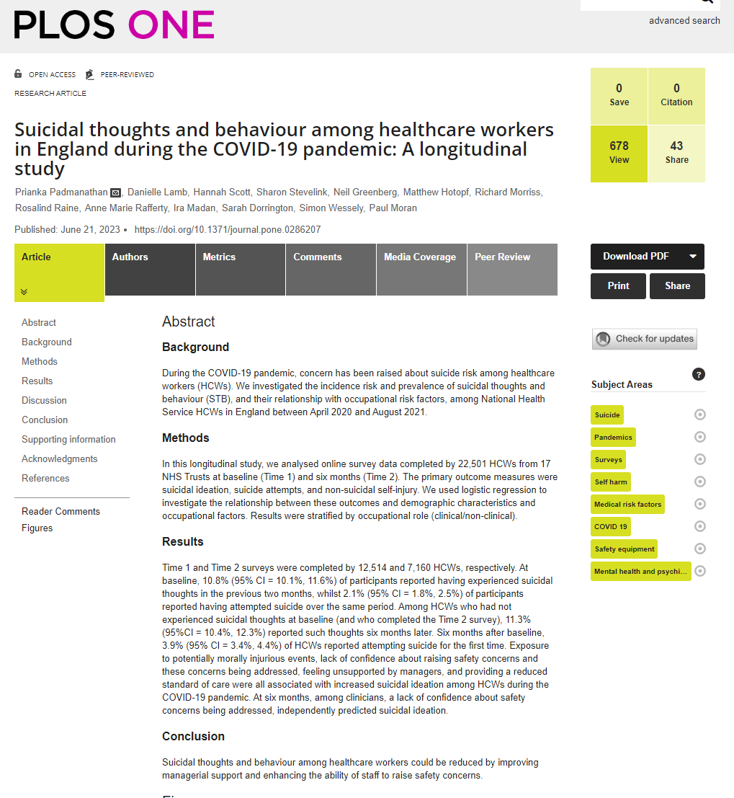
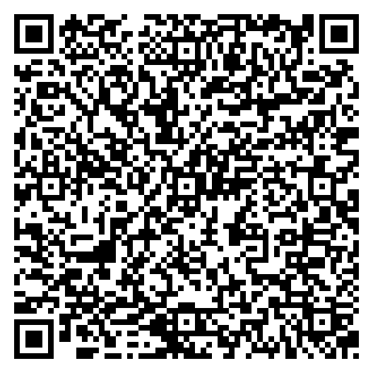
https://journals.plos.org/plosone/article?id=10.1371/journal.pone.0286207#sec005

Slide 3
Background
During the COVID-19 pandemic, concern has been raised about suicide risk among healthcare workers (HCWs).
Several very tragic high-profile cases of HCW suicide in media.
Existing evidence base poor (Eyles et al., 2021), e.g. cross-sectional, convenience samples, no sampling frame.
We investigated the incidence risk and prevalence of suicidal thoughts and behaviour (STB), and their relationship with occupational risk factors, among National Health Service HCWs in England between April 2020 and August 2021.
Used data from NHS CHECK (N=23,461), longitudinal surveys of HCWs in 18 Trusts through pandemic.

Slide 4
Methods
Online surveys used CIS-R suicidality questions:.
“Have you ever thought of taking your life, even though you would not actually do it?” (suicidal ideation)
“Have you ever made an attempt to take your life, by taking an overdose of tablets or in some other way?” (suicide attempts)
“Have you ever deliberately harmed yourself in any way but not with the intention of killing yourself?” (non-suicidal self-injury)
Answer options:
Yes, in the past 2 months
Yes, but not in the past 2 months
No

Slide 5
Design
Used data from baseline (n=12,514) and 6 month follow up (n=7,160).
Described proportions reporting suicidal ideation, attempts, and non-suicidal self-injury at each time period, and incidence at 6 months.
Multilevel multivariable logistic regression models (using weighted data).
Investigated associations between outcomes (suicidal ideation, attempts, and non-suicidal self-injury) and demographic factors (age, sex, ethnicity) and occupational factors (re-deployment status; exposure to potentially morally injurious events; lack of access to personal protective equipment (PPE); lack of confidence about raising safety concerns; lack of confidence that safety concerns would be addressed; feeling unsupported by supervisors or managers, and providing a reduced standard of care.

Slide 6
Results – prevalence & incidence
 |  | Prevalence |  |  |  |  |  | Incidence
Time | Response | Suicidal ideation |  | Suicidal attempts |  | Non-suicidal self-injury |  | Suicidal ideation |  | Suicidal attempts |  | Non-suicidal self-injury
 |  | n | % (95% CI) | n | % (95% CI) | n | % (95% CI) | n | % (95% CI) | n | % (95% CI) | n | % (95% CI)
Baseline | No | 8,137 | 65.7 (64.6, 66.7) | 10,927 | 87.2 (86.4, 88.0) | 10,262 | 82.3 (81.4, 83.1) | - | - | - | - | - | -
 | Yes, but not in previous 2 months | 2,596 | 19.5 (18.7, 20.4) | 880 | 6.7 (6.1, 7.3) | 1,397 | 10.3 (9.7, 11.0) | - | - | - | - | - | -
 | Yes, within the previous 2 months | 1,336 | 10.8 (10.1, 11.6) | 262 | 2.1 (1.8, 2.5) | 407 | 3.4 (3.0. 3.8) | - | - | - | - | - | -
6 months | No | 4,308 | 61.4 (60.0, 62.8) | 5,897 | 82.7 (81.5, 83.8) | 5,532 | 78.2 (77.0, 79.4) | 3,707 | 80.2 (79.0, 81.5) | 5,546 | 87.7 (86.9, 88.5) | 5,098 | 86.7 (84.8, 86.6)
 | Yes, but not in the previous month | 1,591 | 21.0 (19.8, 22.2) | 475 | 6.3 (5.6, 7.0) | 776 | 9.9 (9.1, 10.8) | 343 | 7.4 (6.7, 8.2) | 119 | 1.9 (1.6, 2.2) | 226 | 3.8 (3.3, 4.3)
 | Yes, within the previous month | 638 | 9.0 (8.1, 9.9) | 164 | 2.4 (2.0, 2.9) | 226 | 3.2 (2.7, 3.7) | 181 | 3.9 (3.4, 4.5) | 125 | 2.0 (1.6, 2.4) | 134 | 2.3 (1.9, 2.7)
Notes:
The estimated incidence risk of first-time suicide attempts was 3.9% (95% CI=3.4%, 4.4%; n=244/6,323 people who had not reported previous suicide attempts at Time 1 and also completed Time 2). The estimated incidence risk of first-time non-suicidal self-injury was 6.1% (95% CI=5.5%, 6.7%; n=360/5,949 people who had not reported previous non-suicidal self-injury at Time 1 and completed Time 2).

Slide 7
Results – prevalence & incidence
 |  | Prevalence |  |  |  |  |  | Incidence
Time | Response | Suicidal ideation |  | Suicidal attempts |  | Non-suicidal self-injury |  | Suicidal ideation |  | Suicidal attempts |  | Non-suicidal self-injury
 |  | n | % (95% CI) | n | % (95% CI) | n | % (95% CI) | n | % (95% CI) | n | % (95% CI) | n | % (95% CI)
Baseline | No | 8,137 | 65.7 (64.6, 66.7) | 10,927 | 87.2 (86.4, 88.0) | 10,262 | 82.3 (81.4, 83.1) | - | - | - | - | - | -
 | Yes, but not in previous 2 months | 2,596 | 19.5 (18.7, 20.4) | 880 | 6.7 (6.1, 7.3) | 1,397 | 10.3 (9.7, 11.0) | - | - | - | - | - | -
 | Yes, within the previous 2 months | 1,336 | 10.8 (10.1, 11.6) | 262 | 2.1 (1.8, 2.5) | 407 | 3.4 (3.0. 3.8) | - | - | - | - | - | -
6 months | No | 4,308 | 61.4 (60.0, 62.8) | 5,897 | 82.7 (81.5, 83.8) | 5,532 | 78.2 (77.0, 79.4) | 3,707 | 80.2 (79.0, 81.5) | 5,546 | 87.7 (86.9, 88.5) | 5,098 | 86.7 (84.8, 86.6)
 | Yes, but not in the previous month | 1,591 | 21.0 (19.8, 22.2) | 475 | 6.3 (5.6, 7.0) | 776 | 9.9 (9.1, 10.8) | 343 | 7.4 (6.7, 8.2) | 119 | 1.9 (1.6, 2.2) | 226 | 3.8 (3.3, 4.3)
 | Yes, within the previous month | 638 | 9.0 (8.1, 9.9) | 164 | 2.4 (2.0, 2.9) | 226 | 3.2 (2.7, 3.7) | 181 | 3.9 (3.4, 4.5) | 125 | 2.0 (1.6, 2.4) | 134 | 2.3 (1.9, 2.7)
Notes:
The estimated incidence risk of first-time suicide attempts was 3.9% (95% CI=3.4%, 4.4%; n=244/6,323 people who had not reported previous suicide attempts at Time 1 and also completed Time 2). The estimated incidence risk of first-time non-suicidal self-injury was 6.1% (95% CI=5.5%, 6.7%; n=360/5,949 people who had not reported previous non-suicidal self-injury at Time 1 and completed Time 2).

Slide 8
Regression analyses – demographic factors
Demographic factors associated with higher likelihood of reporting suicidal ideation or self-injury, at baseline:
Younger age
Being male
Mixed ethnicity
At 6 months:
Younger age
At both time points, no statistically significant associations between demographics and reporting suicidal attempts.

Slide 9
Regression analyses – occupational factors at baseline
Occupational factors associate with higher likelihood of reporting suicidal ideation, at baseline:
Lack of confidence in raising safety concerns (clinical & non-clinical)
Lack of confidence safety concerns will be addressed (clinical & non-clinical)
Lack of access to adequate PPE (non-clinical)
Lack of support from managers (clinical & non-clinical)
Having to provide a worse standard of care than usual (clinical)
Experiencing potentially morally injurious events (clinical & non-clinical)

Slide 10
Regression analyses – occupational factors at 6 months
Once we adjusted for all relevant factors (inc. baseline level of relevant outcome), only ONE factor predicted outcomes at 6 months.
Lack of confidence in safety concerns being addressed (at baseline) predicted suicidal ideation in clinical staff at 6 months (AOR 1.45, 95%CI 1.12, 1.89).

Slide 11
Discussion
Five key findings:
1 in 10 participants reported suicidal thoughts in past two months, with 3% reporting self-harm, and 2% reporting attempted suicide.
Of those who’d never had suicidal thoughts, 1 in 10 participants reported reported them at 6 months.
Exposure to moral injury, lack of confidence about raising and management of safety concerns, unsupported by managers, providing worse care, all associated cross-sectionally with STBs.
Baseline lack of confidence about management of safety concerns associated with suicidal thoughts at 6 months (among clinicians).
Re-deployment not associated with STBs (may be due to small numbers).

Slide 12
Conclusions
Our findings that ~30% of HCWs had ever experienced suicidal ideation fits with other work on this, where 31% reported suicidal ideation (Rathod et al., 2020). Higher than population levels (~20%, McManus et al., 2016)
Strengths – Follow up data allowed exploration of predictive factors. Known sampling frame. Weighted data.
Limitations – Still a lot of understand and unpick about what can reliably predict suicidal thoughts and behaviours – e.g. we don’t have pre-pandemic data from this cohort.
Ongoing analysis of 12 and 24 month data to look at outcomes over time.

Slide 13
Thank you
D.Lamb@ucl.ac.uk
http://nhscheck.org
@dannijl
@NHSCHECK1

Slide 14
Conflict of interests
MH, RR, and SW are senior NIHR Investigators.
SW has received speaker fees from Swiss Re for two webinars on the epidemiological impact of COVID 19 pandemic on mental health. SW is a board member of NHS England.
RR reports grants from DHSC/UKRI/ESRC COVID-19 Rapid Response Call, grants from Rosetrees Trust, grants from King's Together rapid response call, grants from UCL (Wellcome Trust) rapid response call, during the conduct of the study; & grants from NIHR outside the submitted work.
MH reports grants from DHSC/UKRI/ESRC COVID-19 Rapid Response Call, grants from Rosetrees Trust, grants from King's Together rapid response call, grants from UCL Partners rapid response call, during the conduct of the study; grants from Innovative Medicines Initiative and EFPIA, RADAR-CNS consortium , grants from MRC, grants from NIHR, outside the submitted work.
SS reports grants from UKRI/ESRC/DHSC, grants from UCL, grants from UKRI/MRC/DHSC, grants from Rosetrees Trust, grants from King's Together Fund, and an NIHR Advanced Fellowship [ref: NIHR 300592] during the conduct of the study.
NG reports a potential COI with NHSEI, during the conduct of the study; and I am the managing director of March on Stress Ltd which has provided training for a number of NHS organisations.
The views expressed are those of the authors and not necessarily those of the NHS, the NIHR, or the Department of Health and Social Care.
Other authors report no competing interests.

Slide 15
Funding
Funding for NHS CHECK was received from the following sources: Medical Research Council (MR/V034405/1); UCL/Wellcome (ISSF3/ H17RCO/C3); Rosetrees Trust (M952 and PGL22/100103); Economic and Social Research Council (ES/V009931/1); NHS England and NHS Improvement; Manolo Blahnik International; Koa Health; Colt Foundation; as well as seed funding from National Institute for Health Research Maudsley Biomedical Research Centre, King's College London, National Institute for Health and Care Research Health Protection Research Unit in Emergency Preparedness and Response at King's College London.

Slide 16
Acknowledgement
We wish to acknowledge the National Institute of Health and Care Research (NIHR) Applied Research Collaboration (ARC) National NHS and Social Care Workforce Group, with the following ARCs: East Midlands, East of England, South West Peninsula, South London, West, North West Coast, Yorkshire and Humber, and North East and North Cumbria. They enabled the set-up of the national network of participating hospital sites and aided the research team to recruit effectively during the COVID-19 pandemic.
The NHS CHECK consortium includes the following site leads: Siobhan Coleman, Sean Cross, Amy Dewar, Chris Dickens, Frances Farnworth, Adam Gordon, Charles Goss, Jessica Harvey, Nusrat Husain, Peter Jones, Damien Longson, Paul Moran, Jesus Perez, Mark Pietroni, Ian Smith, Tayyeb Tahir, Peter Trigwell, Jeremy Turner, Julian Walker, Scott Weich, Ashley Wilkie.
The NHS CHECK consortium includes the following co-investigators and collaborators: Peter Aitken, Ewan Carr, Anthony David, Mary Jane Doherty, Sarah Dorrington, Rosie Duncan, Sam Gnanapragasam, Cerisse Gunasinghe, Stephani Hatch, Danielle Lamb, Daniel Leightley, Ira Madan, Richard Morriss, Isabel McMullen, Dominic Murphy, Martin Parsons, Catherine Polling, Alexandra Pollitt, Anne-Marie Rafferty, Rebecca Rhead, Danai Serfioti, Chloe Simela, Charlotte Wilson Jones.

